Slide 1
Analogue Digital Converters, (ADCs), Random Numbers and Fourier transforms
PHYS3112 – Tutorial 4

Slide 2
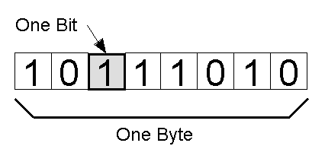
Why do we need ADCs?
Analogue signals exist as a continuous range
Digital signals (including when they’re stored) can only exist as digital, discrete values!
We need some protocol for converting an
Analogue signal into a digital one.

Slide 3
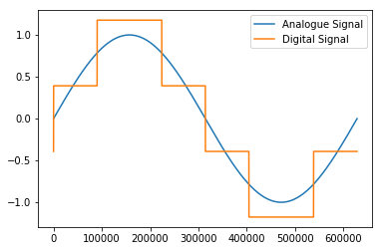
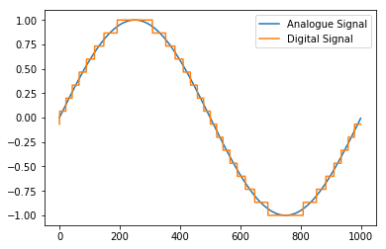
A Basic ADC
The analogue signal is discretised – it is broken up from a series of continuous values into a series of discrete values.
Each ‘real’ value is mapped to the closest possible digital value.

Slide 4
Bit Depth And Range
Bit Depth is the number of bits that are being used to encode the signal.
The total number of possible values is 2^(num_bits).
More bits = finer resolution!
Range is the range of values that the ADC will encode for
If the range is too small, high/low values will be cutoff
If the range is too large, you are wasting a lot of your levels
You need to match the range with the expected signal

Slide 5

Generating Random Numbers
‘Random’ numbers have to come from somewhere
Most pseudo-random number generators will generate random numbers using a highly unstable function
‘True Random’ numbers come from natural sources – there are a lot of sources out there (eg Cosmic Background Radiation)
But how much can be ‘truly random’ if the values are still influenced by our measurement apparatus?

Slide 6
Checking Random Numbers
.Zip it!
File compression works through identifying patterns – if your series of numbers are incompressible, then you have got a good random number generator
Go and write your own (or steal from Wikipedia), save the data and attempt to compress it. See how random you can get!
Michael’s notes on RNGs are super helpful (referenced in the tutorial notebook) and will probably be in the exam.

Slide 7
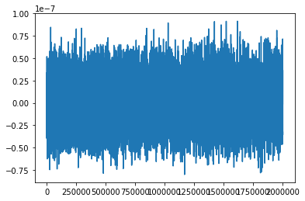
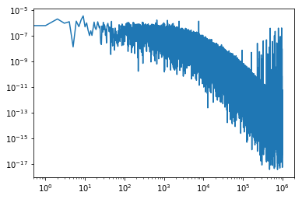
What is the Fourier Transform?
Transforms a signal from time-space to frequency space.
I.e. it displays the frequencies present in a signal.
Complicated Maths!
Inside the Coupled Pendulum Lab!
TIME
“Frequency”

Slide 8
Implementing the Fourier Transform
We will use the Fast Fourier Transform (FFT).
It’s fast – without it, Fourier analysis wouldn’t be as prevalent as it is today.
Call it by passing the time series (as a 1D vector) into the FFT function.
We will be using functions from scipy’s ‘fftpack’. The basic one is scipy.fftpack.fft
FFT
x(t)
X(s)

Slide 9
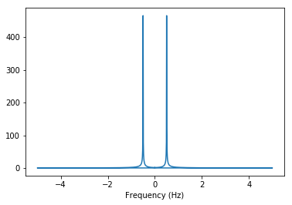
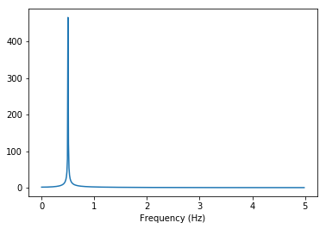
Fourier Jank!
The fourier transform returns complex numbers – so be certain to take the absolute value!
The fourier transform also returns a vector that is centered at frequency = 0, so normally you just take the second half of the data.

Slide 10
Generating Your Frequency Base
The FFT Spits out a vector without a corresponding frequency base.
The frequency vector depends on your sampling rate (timestep) and number of samples
Fortunately numpy and scipy can make this for you using the ‘fftfreq’ command.
What frequencies does this correspond to?

Slide 11
Resolution!
Rule of Thumb: To see low frequencies, sample longer. To see high frequencies, sample FASTER.
If you can’t sample for a longer period of time (i.e. you already gathered your data), then you can zero-pad your data (add a bunch of zeroes to the end!)
You can try this out in the tutorial!

Slide 12
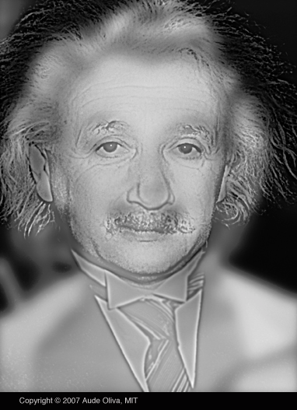
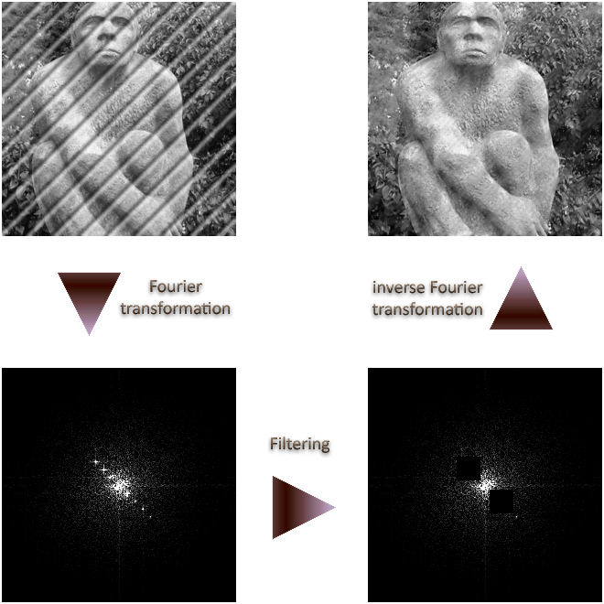
2D Fourier transforms

Slide 13
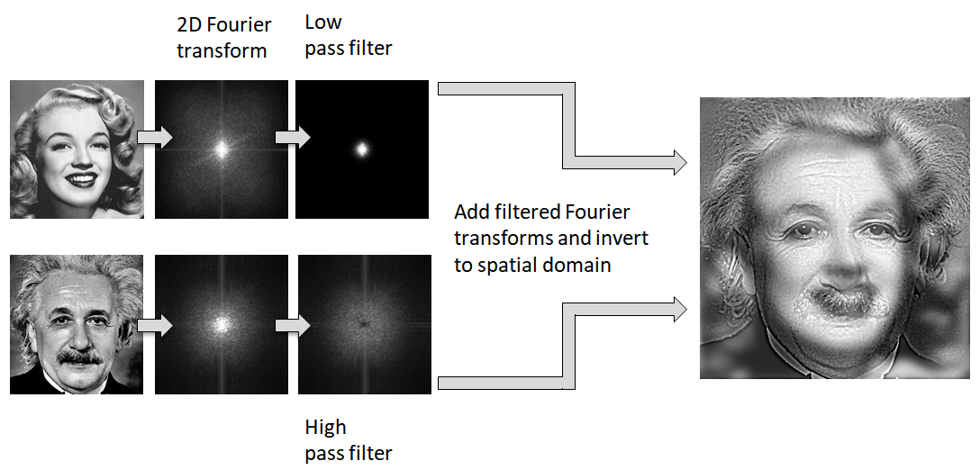
2D Fourier transforms

Slide 14
Further Reading:
‘Elegant SciPy Ch4 - Frequency and the Fast Fourier Transform’
https://learning.oreilly.com/library/view/elegant-scipy/9781491922927/ch04.html

